Slide 1
2
1
Start zone: Sentinel wakes up from a standby pod.
They learn how to activate doors and access different types of rooms.
They learn how to encounter hazards and dangers.
They run into enemies and pain-makers.
They dispatch the obstacles ahead of them.
Lastly, they reach the end of the room.
4
3
\
5
6

Slide 2
Start zone: Sentinel wakes up from a standby pod.
They learn how to activate doors and access different types of rooms.
They learn how to encounter hazards and dangers.
They run into enemies and pain-makers.
They dispatch the obstacles ahead of them.
Lastly, they reach the end of the room.

Slide 3
2
1
3
4
\
5
6

Slide 4
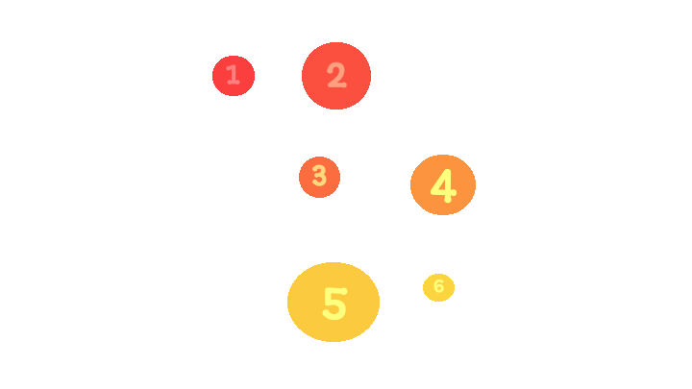

Slide 5
Take Damage
Reduce HP by DMG
Affect Player Character

Slide 6
Do Nothing?
Yes
Dead
No
Take DMG
Input DMG

